Slide 1
Application/Important Keyword
Project title goes here
Your Name
Mentor: <name>

Slide 2
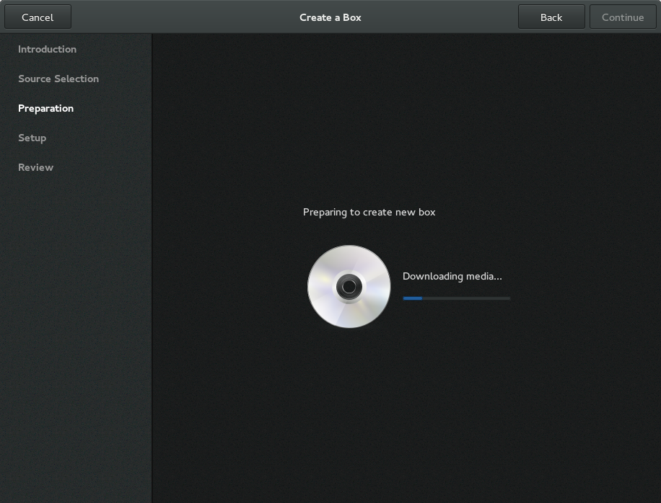
Image With a Title

Slide 3
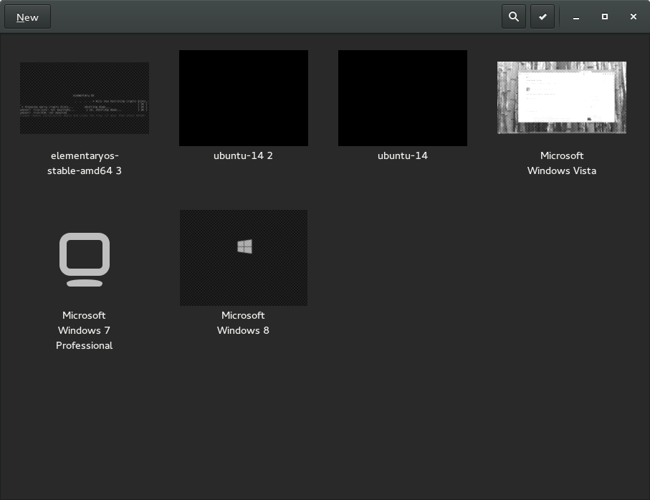

Slide 4
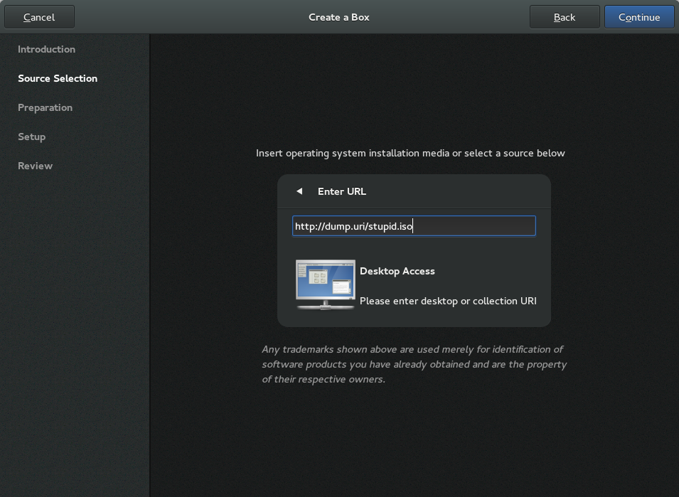

Slide 5
Content Header
Content keyword 1
Content keyword 2
  Content keyword 2.1
  Content keyword 2.2

Slide 6




Important Keyword
This non-free logo is
not available for
your country.
This non-free logo is
not available for
your country.

